Slide 1
Interview Case Study – Engineering Trastuzumab
By: Jinyan Tao
T

Slide 2
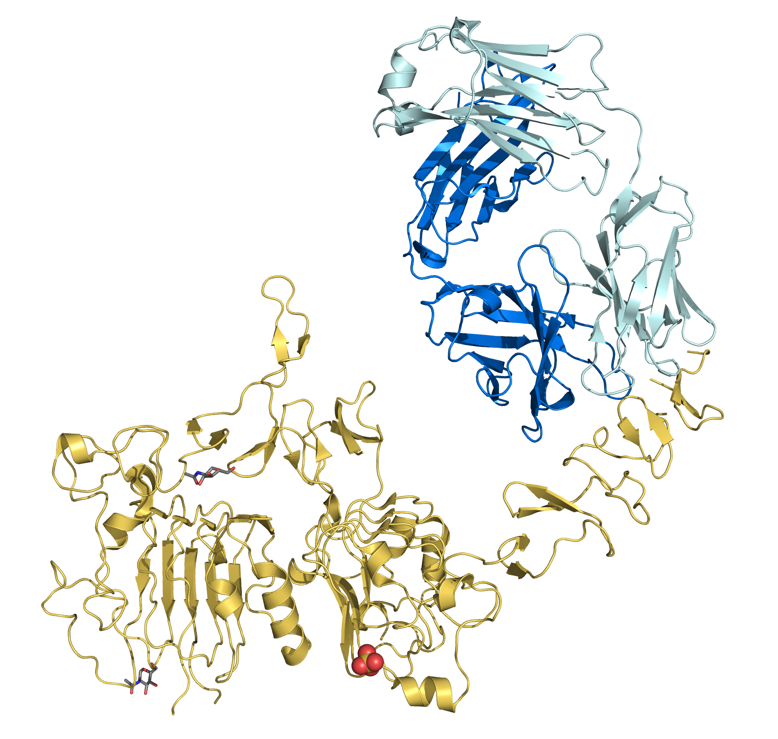
Task 1: Predicting the binding status of novel Trastuzumab Variants
Trastuzumab
ERBB2
https://en.wikipedia.org/wiki/HER2/neu

Slide 3
Task 1: Predicting the binding status of novel Trastuzumab Variants
Key outline:
Quality control
&
Exploratory data analysis
Feature
Engineering/Extraction
Classification
Model evaluation
Conclusion
&
Discussion
Final prediction see: https://github.com/PinaColadast/CDR3_prediction_case/blob/main/task1_predicted.csv
Implementation details see https://github.com/PinaColadast/CDR3_prediction_case/blob/main/deepCDR_task1.ipynb

Slide 4
Task 1: Predicting the binding status of novel Trastuzumab Variants
Quality control and exploratory data analysis

Slide 5
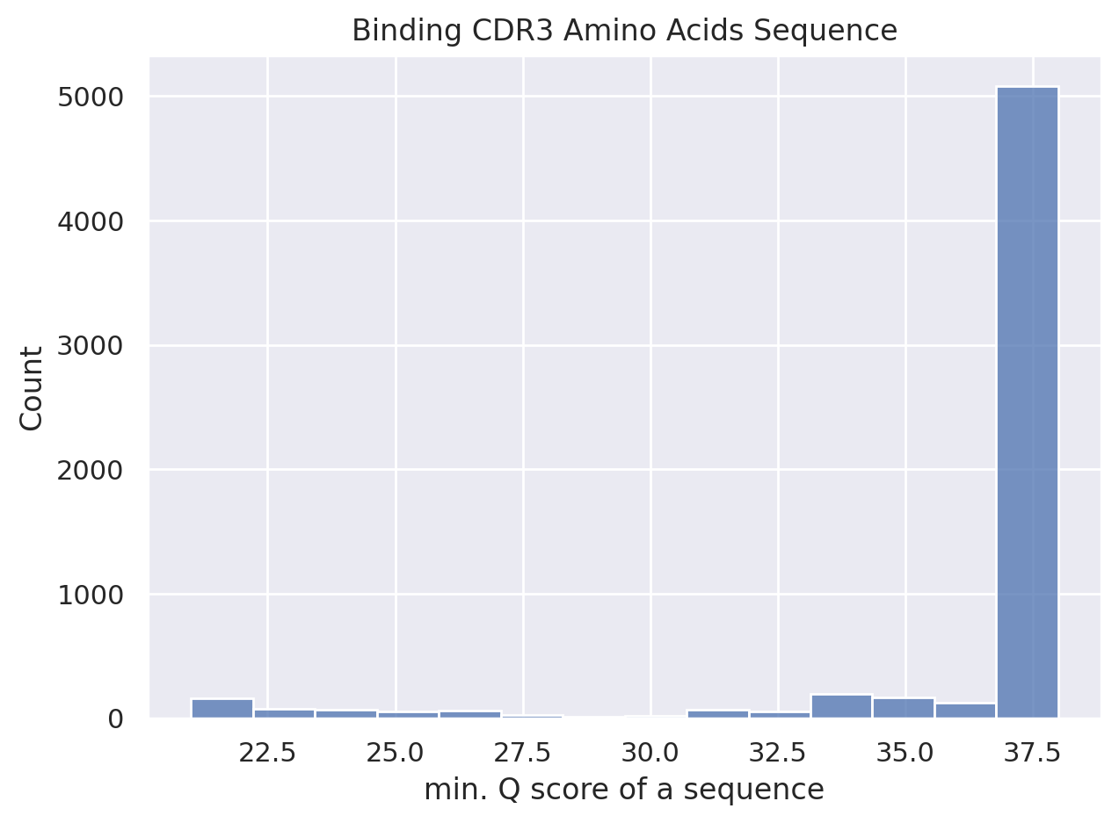
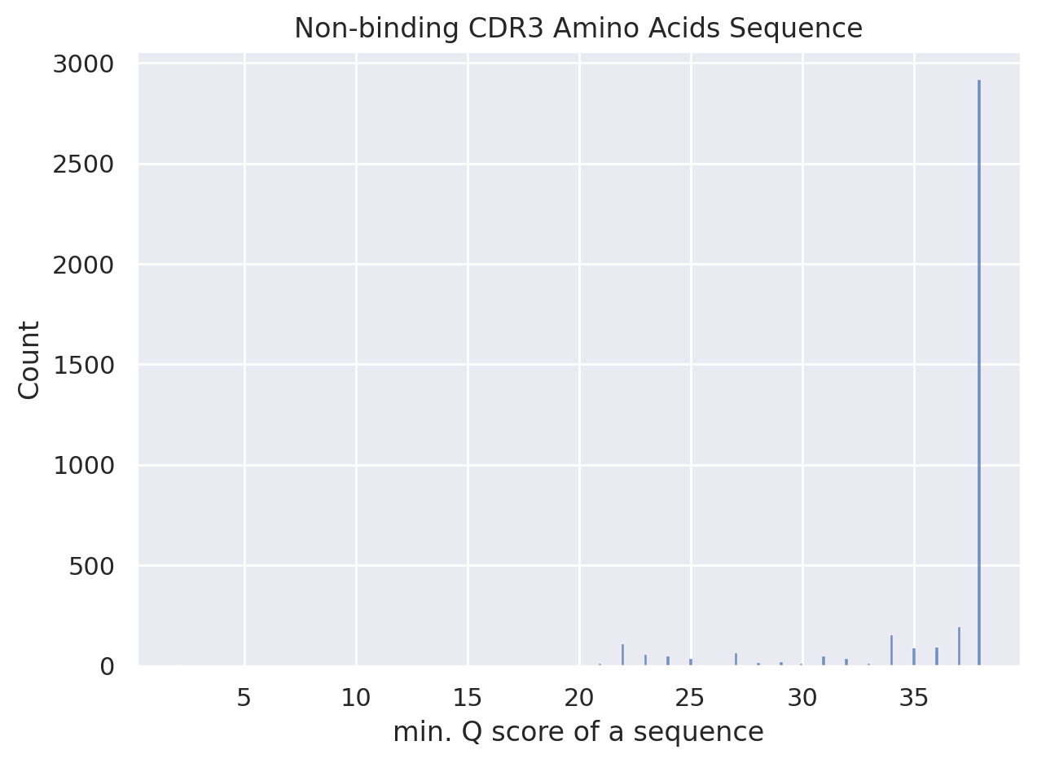
Data quality check
Applied Q score to ensure sequence quality control:
Phred Score (Q score), thershold 25
Exclude any sequence with if any base with Q score less than 25
A rule of thumb cut-off is 20~30, apply an intermediate thereshold 25 should guarantee high sequence quality
Figure 1: histgrams of binders and non-binders min.Q score distrubtion. All sequences show min.Q score larger than 20
[1] Q-score calculated referencing https://drive5.com/usearch/manual/quality_score.html

Slide 6
Data quality check
Applied Q score to ensure sequence quality control (QC):
Q score with thershold 25
Exclude any sequence with if any base with Q score less than 25
A rule of thumb cut-off is 20~30, apply a moderate thereshold 25 should guarantee high sequence quality
Deleted repetitive binders and non-binders with identical CDR3 amino acid sequence, however with altered CDR3 nucleotide sequence (due to codon degeneracy)
Number of Binder* entries |  | Number of Non-binder entries
Before QC | After QC | Before QC | After QC
6146 | 3725 | 3888 | 3620
=> After two steps, data was used for downstream analysis
* note: for binders, two dataset was merged and performed quality check
[1] Q-score calculated referencing https://drive5.com/usearch/manual/quality_score.html

Slide 7
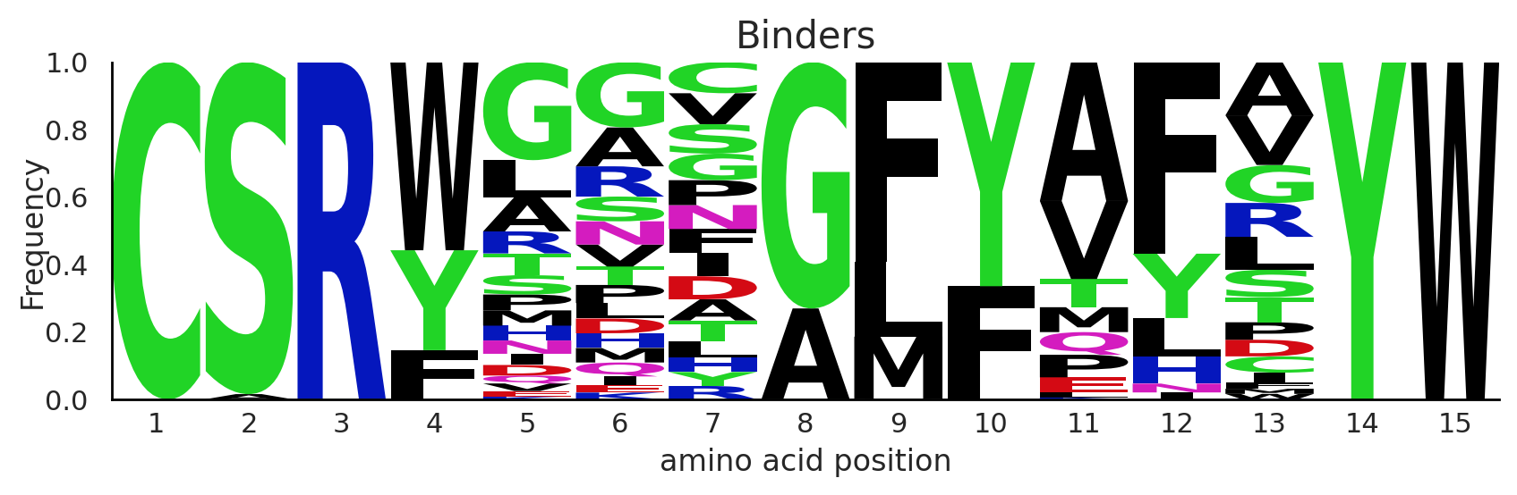
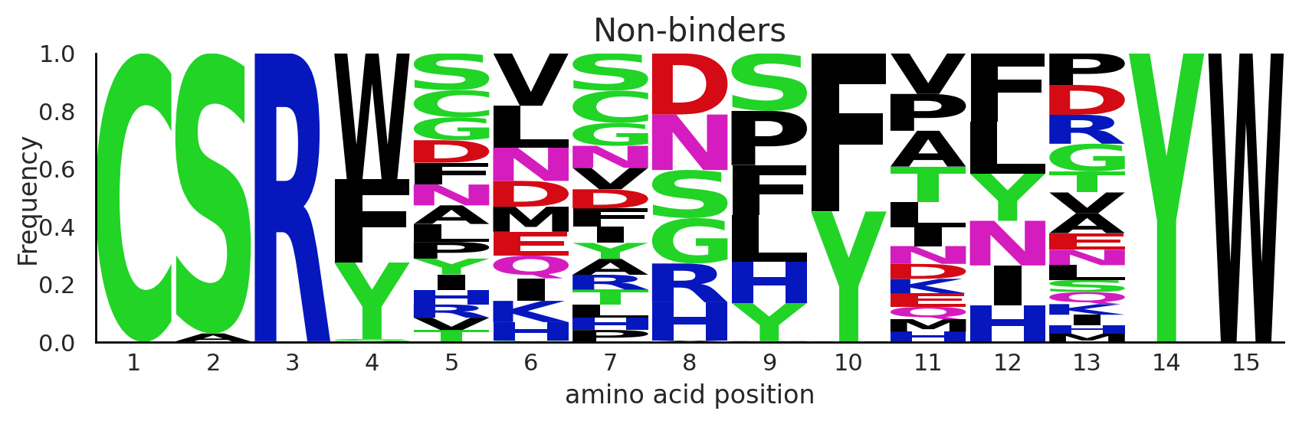
Positional amino acids (AAs) diversity analysis in CDR3 sequences
Length of AA sequences : 15 residues
Binders and non-binders differ mainly from position 5-13
Position 1-3 are moslty CSR, ending residues are YW
Frequency and compositions of AAs from pos. 5-13 vary

Slide 8
Task 1: Predicting the binding status of novel Trastuzumab Variants
Feature engineering

Slide 9
Feature engineering of CDR3 AA sequences representation
Key challenges:
To transform string-like AA sequences to machine readable numeric values
Solutions:
Natural language processing (NLP) approach to learn the data representation
Binary encoding representing ab /presence of AAs
Protein descriptors (protein fingerprints, electrostatic potential properties descriptors etc. )
To reserve positional relationships of AA
Solutions:
Positional one-hot encoding of AAs
Explicit protein descriptors
3. To reserve functional properties of AA
Solutions:
Implicit categorical encoding of 20 natural AAs
Explicit protein descriptors
select AA sequences rather than nucleotide sequencs, as:
AA impacts protein interaction directly
More diverse categories (20) to encode
[1] Journal of Cheminformatics volume 5, Article number: 41 (2013)

Slide 10
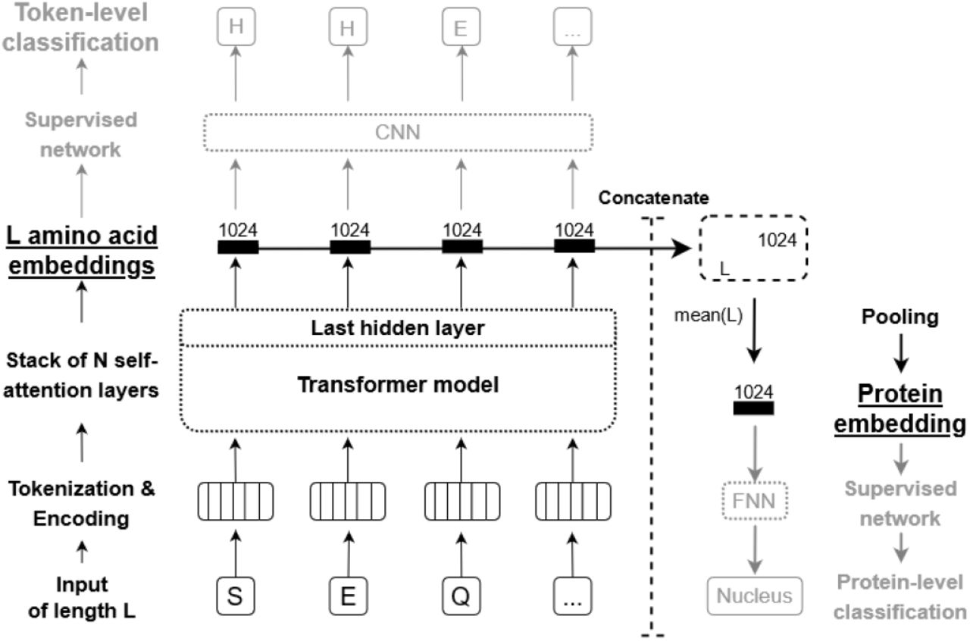
Feature engineering of CDR3 AA sequences
Two feature engineering appraoches were selected
Natural language processing (NLP) approach to learn 1024-vector numeric representation for each sequence
Positional one-hot encoding deriving 15 X 20 matrix to represent each sequence
NLP-based representation learning¹
Key ideas:
Leverage BERT (Bidirectional Encoder Representations from Transformers) model pretrained with large-scale protein sequences to generate representation
Key steps:
Tokenize protein sequence and create positional encoding, feed forward to BERT
Generate 1024-vector embedding for each AA
Concatenate embeddings and average them into one 1024-vector representation
[1] A. Elnaggar et al., "ProtTrans: Towards Cracking the Language of Lifes Code Through Self-Supervised Deep Learning and High Performance Computing," in IEEE Transactions on Pattern Analysis and Machine Intelligence, doi: 10.1109/TPAMI.2021.3095381.
Notes:
https://www.biorxiv.org/content/10.1101/2020.07.12.199554v3.full

Slide 11
Feature engineering of CDR3 AA sequences
Two feature engineering appraoches were selected
Natural language processing (NLP) approach to learn 1024-vector numeric representation for each sequence
Positional one-hot encoding deriving 15 X 20 matrix to represent each sequence
A C D E F G B J MLQRS T V W G
C
S
R
Y
G
V
G
G
M
F
P
Y
V
T
W
0 | 1 | 0 | 0 | 0 | 0 | 0 | 0 | … | 0 | 0 | 0 | 0
0 | 0 | 0 | 0 | 0 | 0 | 0 | 0 | … | 0 | 0 | 0 | 0
0 | 0 | 0 | 0 | 0 | 0 | 0 | 0 | … | 0 | 0 | 0 | 0
0 | 0 | 0 | 0 | 0 | 0 | 0 | 0 | … | 0 | 0 | 0 | 0
0 | 0 | 0 | 0 | 0 | 1 | 0 | 0 | … | 0 | 0 | 0 | 0
0 | 0 | 0 | 0 | 0 | 0 | 0 | 0 | … | 0 | 1 | 0 | 0
0 | 0 | 0 | 0 | 0 | 1 | 0 | 0 | … | 0 | 0 | 0 | 0
0 | 0 | 0 | 0 | 0 | 1 | 0 | 0 | … | 0 |  | 0 | 0
0 | 0 | 0 | 0 | 0 | 0 | 0 | 0 | … | 0 | 0 | 0 | 0
0 | 0 | 0 | 0 | 1 | 0 | 0 | 0 | … | 0 | 0 | 0 | 0
0 | 0 | 0 | 0 | 0 | 0 | 0 | 0 | … | 0 | 0 | 0 | 0
0 | 0 | 0 | 0 | 0 | 0 | 0 | 0 | … |  | 0 | 0 | 1
0 | 0 | 0 | 0 | 0 | 0 | 0 | 0 | … | 0 | 1 | 0 | 0
0 | 0 | 0 | 0 | 0 | 0 | 0 | 0 | … | 0 | 0 | 0 | 1
0 | 0 | 0 | 0 | 0 | 0 | 0 | 0 | … | 0 | 0 | 1 | 0
Key ideas:
each row is a 20-d vector with one-hot encoding represents presence of one AA given 20 natural AAs
15 rows presents AA positions in the whole sequence
Keep positional relationships and diversity representation of AAs
Example
sequence
=>
[1] Mason, D.M., Friedensohn, S., Weber, C.R. et al. Optimization of therapeutic antibodies by predicting antigen specificity from antibody sequence via deep learning. Nat Biomed Eng 5, 600–612 (2021).
Notes:
https://www.biorxiv.org/content/10.1101/2020.07.12.199554v3.full

Slide 12
Task 1: Predicting the binding status of novel Trastuzumab Variants
Classification

Slide 13
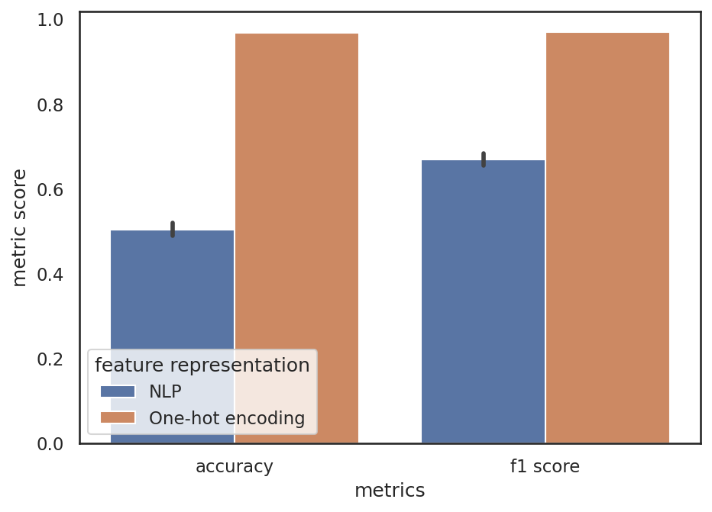
Classification with NLP-learned & one-hot encoded representations:
Positional one-hot encoding outperforms NLP-based representations
10-fold cross validated results
Dataset:
3725 binding sequences
3620 non-binding sequences
train:test = 80:20
Input:
1024-dimensional feature vector
15 X 20 positional encoded matrix
Flattened to 300-d vector for algorithmic convenience
Model:
random forest classifier
Parameters tuned by grid-search
Performance evaluation
10-fold cross-validated
f1, accuracy score

Slide 14
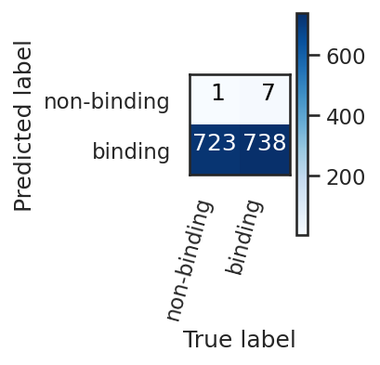
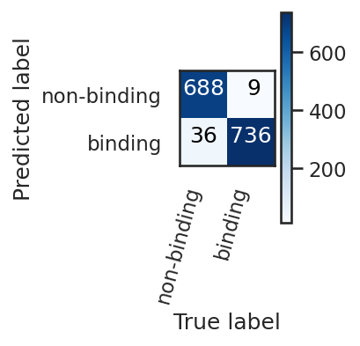
Classification with NLP-learned & one-hot encoded representations:
Positional one-hot encoding (OHE) outperforms NLP-learned representations
Dataset:
3725 binding sequences
3620 non-binding sequences
train:test = 80:20
Input:
1024-dimensional feature vector
15 X 20 positional encoded matrix
Flattened to 300-d vector for algorithmic convenience
Model:
random forest classifier
Parameters tuned by grid-search
Performance evaluation
10-fold cross-validated
f1, accuracy score
Test set result
 | Test - F1 score | Test - accuracy
NLP | 0.669 | 0.503
OHE | 0.970 | 0.968
NLP approach
OHE
Therefore, positional one-hot encoder was seleceted to
benchmark CNN performance (see discussion)

Slide 15
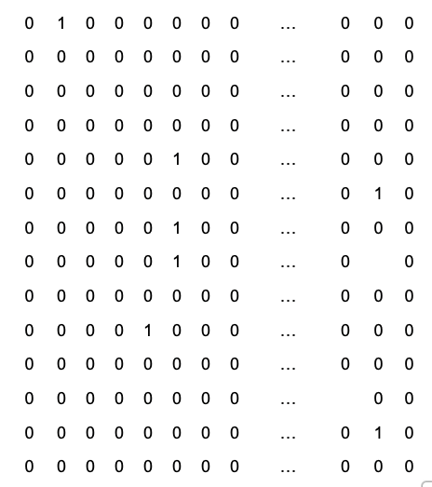
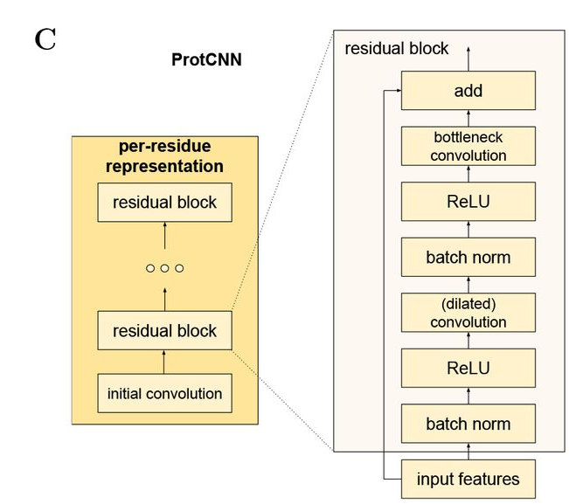
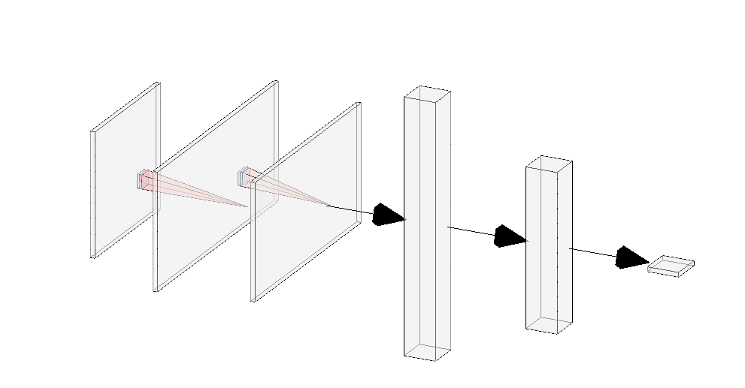
Classification with one-hot encoded representation and Convolutional Neural Networks (CNNs): Res-CNN & Vanilla CN
Res-CNN¹
Vannilla CNN
=
P(binder)
Simple architecture:
Two convolution + max pooling layers
Extract spatial features and reserve spatial relationships (fits AA sequence structure)
- Two dense layers with batch normalization and dropouts to avoid overfitting
Key architecture: CNN + residual blocks + dilated convolution
- Residual blocks: avoid vanishing/exploding gradient problems²
Dilated convolution : increase receptive field size, include more spatial features with less computations
[1] Maxwell L. Bileschi, David Belanger, Drew Bryant, Theo Sanderson, Brandon Carter, D. Sculley, Mark A. DePristo, Lucy J. Colwell bioRxiv 626507; doi: https://doi.org/10.1101/626507
[2] arXiv:1512.03385

Slide 16


Classification with one-hot encoded representation:
Res-CNN slightly outperforms vanilla CNN architecture
Dataset:
3725 binding sequences
3620 non-binding sequences
Train : validation : test = 60:20:20
Input:
15 X 20 positional encoded matrix
Model:
ResCNN & CNN
Trained for 200 epochs with early stopping and regularization
Performance evaluation
Binary entropy loss
F1, accuracy score
 | Test - F1 score | Test - accuracy
Res-CNN | 0.9634 | 0.9632
Vanilla CNN | 0.9627 | 0.9626
Res-CNN
Vanilla CNN

Slide 17
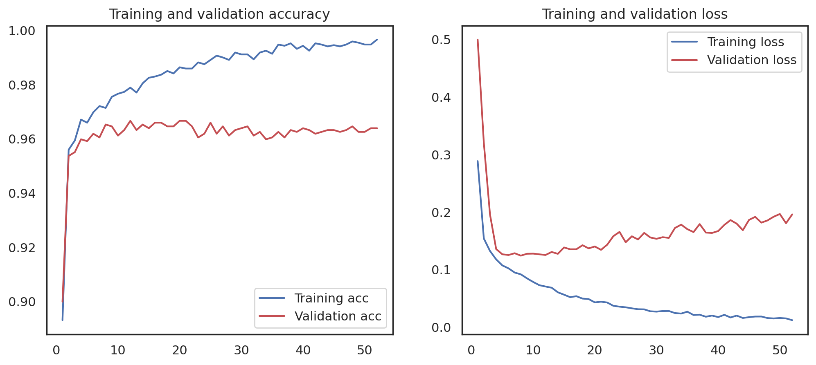
Classification with one-hot encoded representation:
Vanilla CNN architecture training history shows train loss approaches 0 with more epochs, validation loss oscillates after epoch 20
Epochs

Slide 18
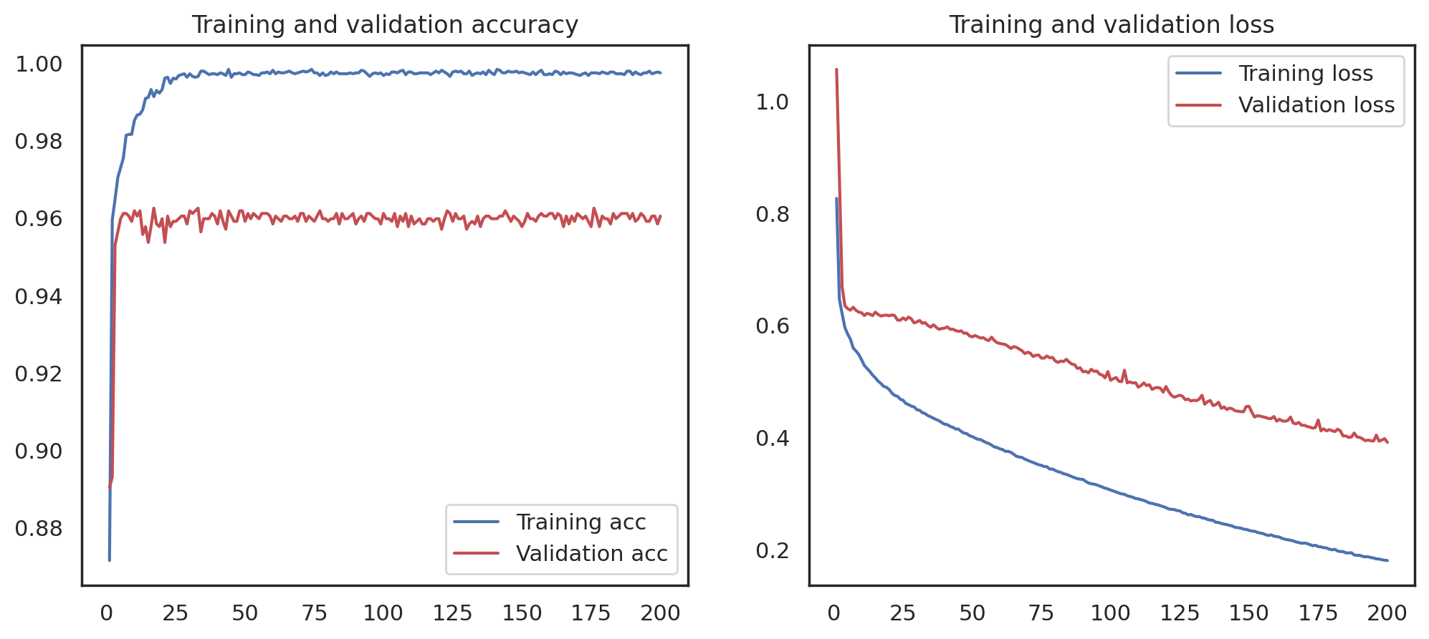
Classification with one-hot encoded representation:
Res-CNN architecture training history shows train loss approaches 0 with more epochs, validation loss keep decreasing with accuracy reaching plateau after epoch 50
Epochs

Slide 19
Task 1: Predicting the binding status of novel Trastuzumab Variants
Conclusion:
1. Highly accurate prediction of binding status of Trastuzumab can be achieved:
Highest: with random forest classifier (positional one-hot encoded) f1 score 0.97, accuracy 0.968
Res CNN slightly outperforms vanilla CNN, slightly less performs the random forest classifier
CDR3 sequence embedding with positional one-hot encoding outperforms representations learned by pretraind BERT model
 | Test - F1 score | Test - accuracy
Res-CNN with OHE | 0.9634 | 0.9632
Vanilla CNN with OHE | 0.9627 | 0.9626
Random forest with NLP encoding | 0.669 | 0.503
Random forest with OHE | 0.970 | 0.968

Slide 20
Task 1: Predicting the binding status of novel Trastuzumab Variants
Discussion & future perspective
Task 1 is a friendly start ☺, the key is to extract feature from the AA sequences
Positional one-hot encoding scheme retains positional relationships between AAs in a sequence
Learned sequence representations are 1024-dimensional numerical vector, might not reserve structural information
Further reasonings can be investigated and postulated
NLP-based approach was chosen out of personal interest/curiosity in experimenting new methods; positional OHE was chosen by its demonstrated good performance in literatures¹ and importance of AA and structural information to protein-antibody binding
Other representations can be experimented: such as protein descriptors
Skipping conventional tokenized & padding approach because:
Sequence is too short (15 residues) to be padded
Padding might lead to incomplete truncation on sequence, results in inaccurate feature extraction
[1] Mason, D.M., Friedensohn, S., Weber, C.R. et al. Optimization of therapeutic antibodies by predicting antigen specificity from antibody sequence via deep learning. Nat Biomed Eng 5, 600–612 (2021).

Slide 21
Task 2: Predicting the Affinity of Novel Trastuzumab Variants Towards HER2
Very challenging problem due to small dataset (90 entries)
Trastuzumab
ERBB2/HER2
https://en.wikipedia.org/wiki/HER2/neu

Slide 22
Task 2: Predicting the Affinity of Novel Trastuzumab Variants Towards HER2
Key outline:
Data augmentation
(with positional one hot encoded features)
Regression &
Model evaluation
Conclusion
&
Discussion
Exploratory data analysis
Final prediction see: https://github.com/PinaColadast/CDR3_prediction_case/blob/main/task2_predicted.csv
Implementation detals see https://github.com/PinaColadast/CDR3_prediction_case/blob/main/deepCDR_task2.ipynb

Slide 23
Task 2: Predicting the Affinity of Novel Trastuzumab Variants Towards HER2
Exploratory data analysis

Slide 24
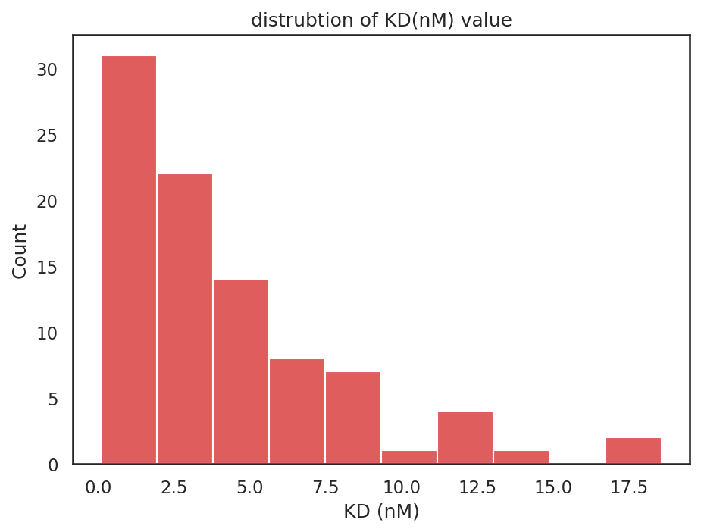
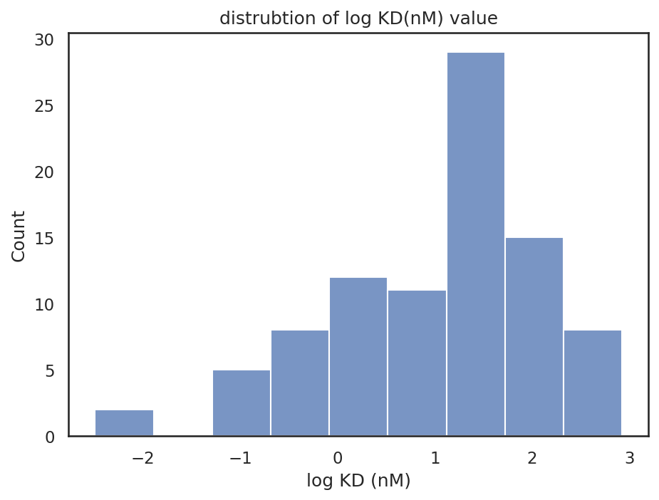
Log(natural) normalization of KD values
KD values exhibits right skewed distibution and with large fold gap between small and large values
Log normalization of KD values gives less sample variance and smaller fold gap
Sequencing quality control was skipped due to absence of sequencing quality data (assuming high quality)
No repetitive data entries
Figure: histgrams of binding affinity distributions

Slide 25
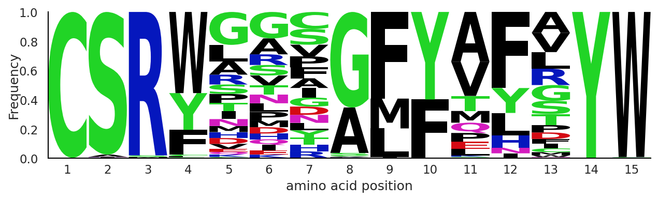
Sequence diversity analysis
Length of AA sequences : 15 residues
similar residue compositions and positions as data from task 1,
Pos 1-3 : CSR mostly
Pos 14-15: YW

Slide 26
Task 2: Predicting the Affinity of Novel Trastuzumab Variants Towards HER2
Data Augmentation

Slide 27
Data augmentation scheme
Key challenges: 90 entry points
predict numerical values with such big range with small amount of data available
in the case of small data regime, here presented my decision process:
Dashed arrow = no go
Solid arrow, bold fonts = go
Whether we can collect more data?
If Yes
No
Go and collect more data,
So far there are no other HER2-antibody binding available after keyword search on public database
Learning with original data
Learning with data augmentation
Transfer learning with pretrained affinity model (no large-scale model founded)
Protein/AA sequence augmentation methods

Slide 28
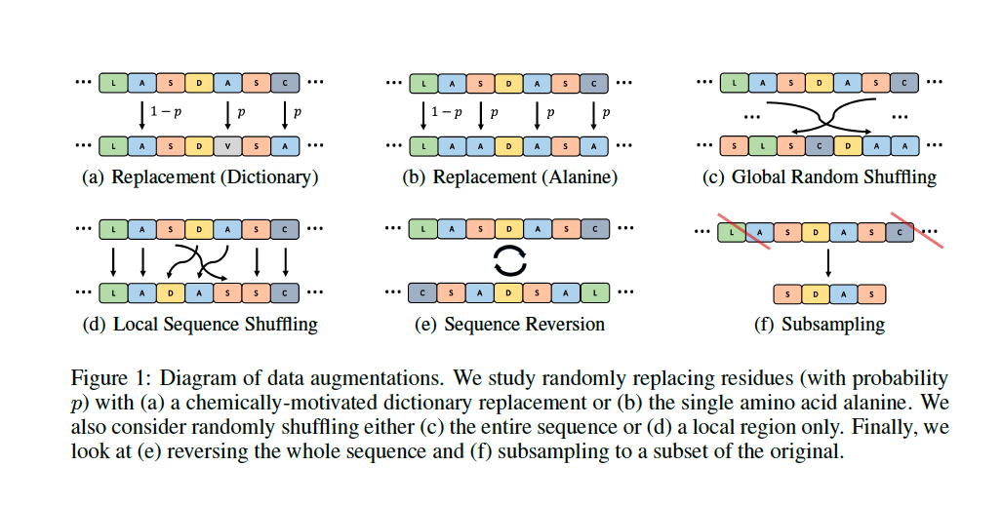
Protein/AA sequence augmentation methods
Literature research has benchmarked AA sequence augmentation methods and highlighted its generailizibitliy
Replacing residues (with probability p) with residues of most similar chemical properties^{1,2}
Retains AA properties that are crucial to bindng such as. Hydrogen donor/receptors
[1] Hongyu Shen, Layne C. Price, Taha Bahadori, Franziska Seeger doi: https://doi.org/10.1101/2021.02.18.431877
[2] French, S., Robson, B. What is a conservative substitution?. J Mol Evol 19, 171–175 (1983). https://doi.org/10.1007/BF02300754

Slide 29
Protein/AA sequence augmentation methods with replacement of chemically similar residues
The adaptation of replacement augmentation has following steps:
Randomly select 1 position in each AA sequence (typically position 4-13, as 1-3, 14-15 are highly conserved )
With probability 0.1, the residue will be replaced, chance of 0.9 it won’t be replaced
Replacement follows pairwise rule: *
Repeat 1-3 steps 100 times for each sequence
Corresponding affinity value is simulated from parent log KD value plus 1% Gaussian noise ~N(0,1)
A:V, S:T, F:Y, K:R, C:M, D:E, N:Q, V:I, P:P, G:G, W:W, H:H, T:S, Y:F, M:C, E:D, Q:N, L:L, R:K, I:V
Repeat 100 times for each sequence
Affinity’ = 99% * Affinity + 1% * N(0,1)
=> To simulate experiments measure variance
* note: proline (only backbone cyclic), glycine (only an H side-chain), tryptophan (indole side chain), or histidine (basic side chain with no size or chemical reaction equivalent) remains same residue
[1] Hongyu Shen, Layne C. Price, Taha Bahadori, Franziska Seeger doi: https://doi.org/10.1101/2021.02.18.431877

Slide 30
Feature engineering of CDR3 AA sequences
Positional one-hot encoding deriving 15 X 20 matrix to represent each sequence:
Selected by task 1 benchmark result
Positional one-hot encoding²
A C D E F G B J MLQRS T V W G
C
S
R
Y
G
V
G
G
M
F
P
Y
V
T
W
0 | 1 | 0 | 0 | 0 | 0 | 0 | 0 | … | 0 | 0 | 0 | 0
0 | 0 | 0 | 0 | 0 | 0 | 0 | 0 | … | 0 | 0 | 0 | 0
0 | 0 | 0 | 0 | 0 | 0 | 0 | 0 | … | 0 | 0 | 0 | 0
0 | 0 | 0 | 0 | 0 | 0 | 0 | 0 | … | 0 | 0 | 0 | 0
0 | 0 | 0 | 0 | 0 | 1 | 0 | 0 | … | 0 | 0 | 0 | 0
0 | 0 | 0 | 0 | 0 | 0 | 0 | 0 | … | 0 | 1 | 0 | 0
0 | 0 | 0 | 0 | 0 | 1 | 0 | 0 | … | 0 | 0 | 0 | 0
0 | 0 | 0 | 0 | 0 | 1 | 0 | 0 | … | 0 |  | 0 | 0
0 | 0 | 0 | 0 | 0 | 0 | 0 | 0 | … | 0 | 0 | 0 | 0
0 | 0 | 0 | 0 | 1 | 0 | 0 | 0 | … | 0 | 0 | 0 | 0
0 | 0 | 0 | 0 | 0 | 0 | 0 | 0 | … | 0 | 0 | 0 | 0
0 | 0 | 0 | 0 | 0 | 0 | 0 | 0 | … |  | 0 | 0 | 1
0 | 0 | 0 | 0 | 0 | 0 | 0 | 0 | … | 0 | 1 | 0 | 0
0 | 0 | 0 | 0 | 0 | 0 | 0 | 0 | … | 0 | 0 | 0 | 1
0 | 0 | 0 | 0 | 0 | 0 | 0 | 0 | … | 0 | 0 | 1 | 0
=>
[1] A. Elnaggar et al., "ProtTrans: Towards Cracking the Language of Lifes Code Through Self-Supervised Deep Learning and High Performance Computing," in IEEE Transactions on Pattern Analysis and Machine Intelligence, doi: 10.1109/TPAMI.2021.3095381.
[2] Mason, D.M., Friedensohn, S., Weber, C.R. et al. Optimization of therapeutic antibodies by predicting antigen specificity from antibody sequence via deep learning. Nat Biomed Eng 5, 600–612 (2021).
Notes:
https://www.biorxiv.org/content/10.1101/2020.07.12.199554v3.full

Slide 31
Task 2: Predicting the Affinity of Novel Trastuzumab Variants Towards HER2
Regression

Slide 32
Regression with original data and data augmentation:
With simplest K nearest neighbor regressor (no restriction on data size)
Test set performance
Dataset:
original data: 90
train:test = 80:20
Augmented training set: 4000
Randomly selected from 5700 augmented traning data
Input:
15 X 20 positional encoded matrix
Flattened to 300-d vector for algorithmic convenience
Model:
KNN regressor: k=4
Hamming loss as distance metrics
Simiar to levenstein distance but normalized by length of vector
Parameters tuned
Performance evaluation
Spearman rank correlation & mean squared error (MSE) (based on natural logarithm level)
 | Rank correlation | MSE (log KD)
With augmentation | 0.324 (p-value<0.01) | 1.200
Without augmentation | 0.690 (p-value<0.01) | 0.760
KNN performs better without data augmentation
Rank correaltion shows moderate-strong correlation

Slide 33
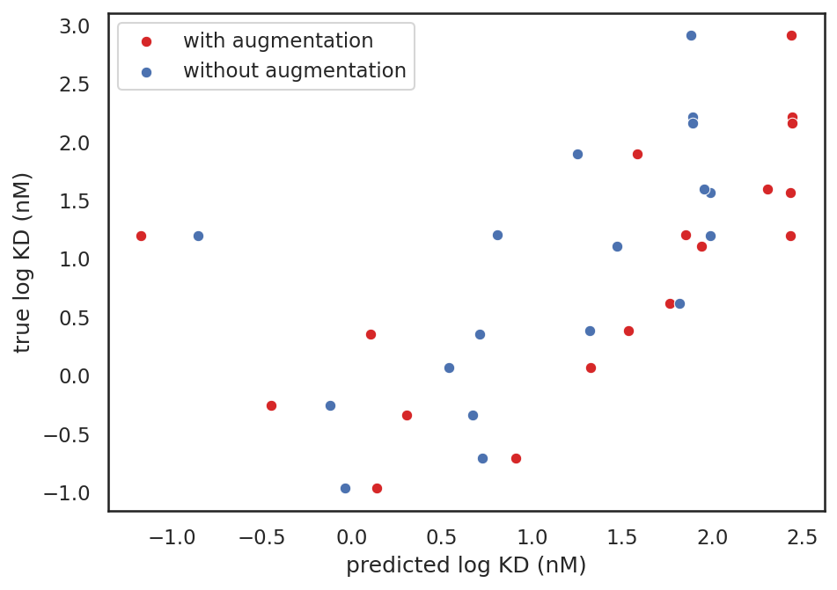
Regression with original data and data augmentation:
With simplest K nearest neighbor regressor (no restriction on data size)
Dataset:
original data: 90
train:test = 80:20
Augmented training set: 4000
Randomly selected from 5700 augmented traning data
Input:
15 X 20 positional encoded matrix
Flattened to 300-d vector for algorithmic convenience
Model:
KNN regressor : k = 4
Hamming loss as distance metrics
Simiar to levenstein distance but normalized by length of vector
Parameters tuned
Performance evaluation
Spearman rank correlation & mean squared error (MSE) (based on natural logarithm level)
KNN performs better without data augmentation
predidcted value shifted by larger error with augmentation
KNN can’t handle noise very well, only extropolate values from distance relationships

Slide 34
Regression with data augmentation and Res-CNN
Dataset:
Augmented training set: 4000
Randomly selected from 5700 augmented traning data
Train: Test = 80:20
Input:
15 X 20 positional encoded matrix
Model:
Res-CNN
Similar model architecture to task1 adapted to regression
Performance evaluation
Spearman rank correlation & mean squared error (MSE) (based on natural logarithm level)
Test set performance
 | Rank correlation | MSE (log KD)
With augmentation | 0.702 | 0.82
Without augmentation | NA, model not converge due to too small data points | 0.760

Slide 35
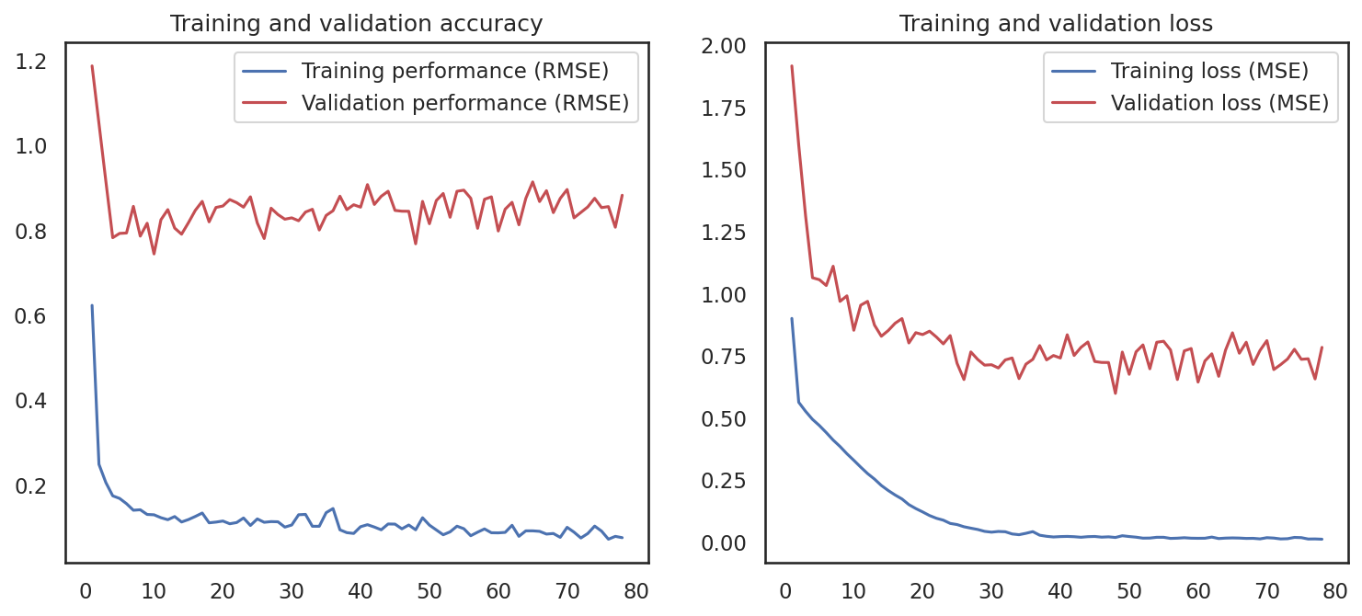
Regression with Res-CNN
Res-CNN architecture training history shows training loss approaches 0 with more epochs, validation loss oscillates, perhaps due to stuck in local minimum or overfits the training set
Epochs

Slide 36
Regression with simple KNN slightly outperforms Res-CNN
Dataset:
Augmented training set: 4000
Randomly selected from 5700 augmented traning data
Train: Test = 80:20
Input:
15 X 20 positional encoded matrix
Model:
Res-CNN
Similar model architecture to task1 adapted to regression
Performance evaluation
Spearman rank correlation & mean squared error (MSE) (based on natural logarithm level)
Test set performance comparison
 | Rank correlation | MSE (log KD)
KNN With augmentation | 0.324 | 1.200
Res-CNN with augmentation | 0.702 | 0.82
KNN without augmentation | 0.690 | 0.760
Res-CNN Without augmentation | NA, model not converge due to too small data points | 0.760
Res-CNN shows worse MSE and slightly better rank correlation

Slide 37
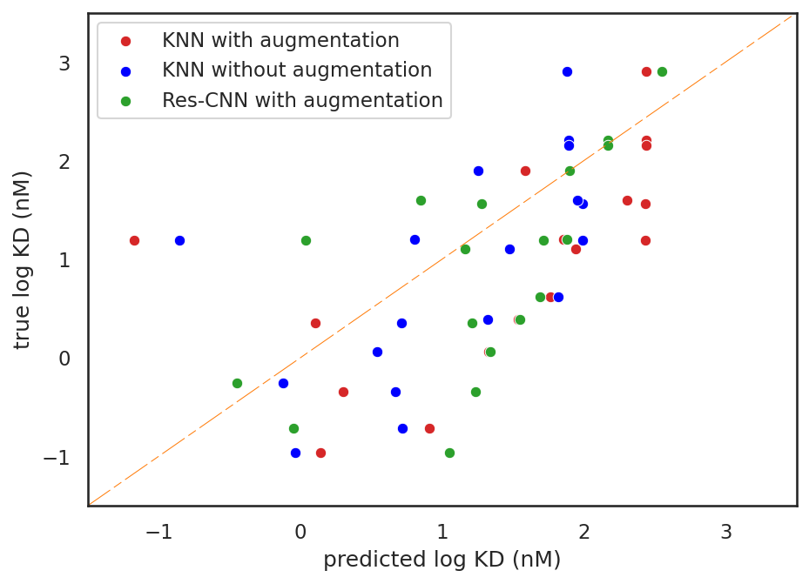
Regression with simple KNN slightly outperforms Res-CNN with data augmentation
Dataset:
Augmented training set: 4000
Randomly selected from 5700 augmented traning data
Train: Test = 80:20
Input:
15 X 20 positional encoded matrix
Model:
Res-CNN
Similar model architecture to task1 adapted to regression
Performance evaluation
Spearman rank correlation & mean squared error (MSE) (based on natural logarithm level)

Slide 38
Task 2: Predicting the Affinity of Novel Trastuzumab Variants Towards HER2
Conclusion:
Challenging task to predict acurrately with low data regime
With data augmentation scheme:
KNN performs worse than without augmentation
Pros: Might perform well under low data regime given selection of representative training data
Cons: KNN extropolate distance relationships between data points and performs weighted sum of neighbors
Res-CNN performs better with augmentation
Pros: Neural networks learns well with noisy and synthetic data
Cons: Deep learning requires larger dataset

Slide 39
Task 2: Predicting the Affinity of Novel Trastuzumab Variants Towards HER2
Future perspective:
More robust data augmentation techniques can be experimented
e.g. masking tokens in AA sequences
Literature¹ highlights other robust augmentation skills however without providing example code and algorithm, challenging to implement within limited timeframe
Transfer learning with pretrained protein properties model
Not so many large-scale affinity prediction data available
there might be other protein properties prediction dataset available, pretrained model can be used to initiate training => needs further research
more robust prediction algorithms (or postulate mathematical relationships between features and affinity )
Check prediction outliers to diagnose wrong prediction
5. Best approach:
Generate more data with experiment measurement ☺ (if possible)
Molecular simulation to mimic protein-antibody binding affnity as ground truth…(less recommended)
[1] Hongyu Shen, Layne C. Price, Taha Bahadori, Franziska Seeger doi: https://doi.org/10.1101/2021.02.18.431877

Slide 40

Thank you! For details of implementation (code) please check: https://github.com/PinaColadast/CDR3_prediction_case

Slide 41
Back-up Slides

